Slide 1

Financial Benchmarking & Strategy to Scale Community-Led Impact
GWU Consulting Team
Aditya Gupta
Ji Hoon Park
Max Tanz
Oscar Basil
Falguni Shah

Slide 2
Table of Contents
Section 1: Executive Context
Section 2: Situation Analysis
Section 3: Competitive Benchmarking
Section 4: Strategy & Roadmap

Slide 3
Executive Summary
Goal:
Assist GlobalGiving in assessing its financial competitiveness by conducting financial benchmarking analysis.
Providing strategic growth recommendations to raise $1Bn by 2028.
Strategy: Diversified revenue streams, expansion in 5 new countries, global donor base, digital-first platform, partnerships, personalization.
Investment Ask: $50M across 3 years; target ROI: 10x in donor value.
Strategic Benefit: Enables scale, increases platform visibility, and builds institutional trust among donors, funders, and nonprofits. 10–12x with long-term resilience.
Just as Netflix revolutionized access to entertainment and Uber transformed transportation, GlobalGiving should aim to redefine philanthropy — on-demand, borderless, personalized.

Slide 4
Vision & Strategic Objectives
Project Objective
Benchmark Competitor Financials
Aims to raise total of $1B in funding by 2028
Strategic Imperatives
Strengthen innovative revenue-generation models
Prioritize engagement with high-net-worth individuals
Recent Trends
Fluctuating revenue over the last two years due to…
Decrease in Corporate Clients
Increase in High Net Worth (HNW) Clients
The revenue forecast, primarily consisting of professional and transaction fees, has largely been deficit..

Slide 5
Situation Analysis
Problem Statement
SWOT Analysis- Financials
SWOT Analysis- Non- Financials
Digital Donor Growth Trends
Market Strategy – 5 Pillars
Top 15 WGI Ranking

Slide 6
Problem Statement
Issue
Lack of full-scale mobile optimization, multilingual UX, and predictive donor journey mapping
Long vetting process
Key Findings
Over 89% of donations currently originate from the US
Lower Repeat Donors/Retention Rate
Key Challenges
Revenue volatility due to a decline in marketplace activity and reduced support from corporate donors
Internal product development lag, with slower-than-expected growth in offerings like Atlas, impacting projected revenue streams.
Budget deficit due to decreased transaction/service fee income
CryptoCurrency donations not being accepted (partnership with Endaoment, yet to go-live)
Like Blockbuster before streaming, traditional giving models haven’t adapted to the way people engage today — GlobalGiving must evolve like Spotify did for music.

Slide 7
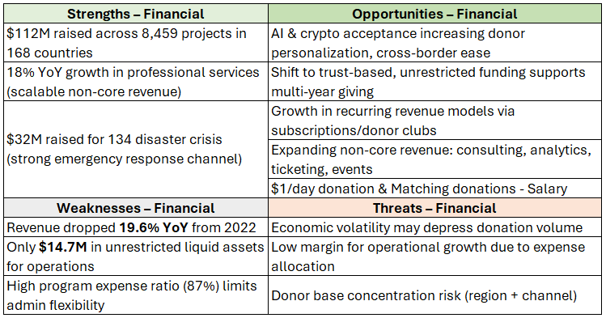
SWOT Analysis – Financials (2023)
Reviewing GlobalGiving’s Form 990 for fiscal year 2023, the accurate program expense ratio is approx 96.3%, calculated using figures from Page 2, Line 4e (Program Service Expenses: $106,314,699) and Page 3, Line 18 (Total Expenses: $110,437,529).
GlobalGiving would rank third among the organizations we compared

Slide 8
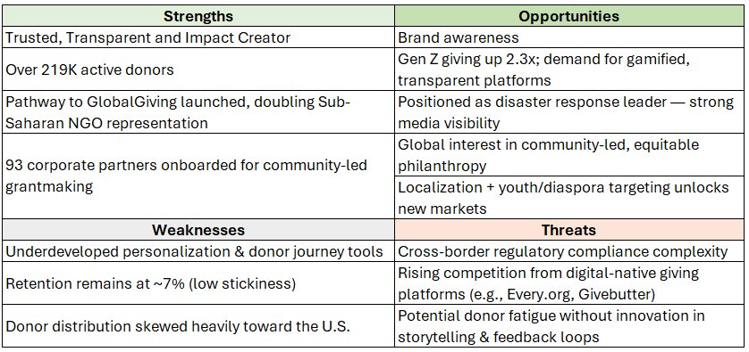
SWOT Analysis - Non Financials (2023)

Slide 9
Digital Donor Growth Trends
Recurring Giving:
In 2023, 57% of donors participated in recurring giving and we saw a 46% increase in YoY.
Monthly donations now account for 31% of all online giving, with an average monthly gift of $24 ($288 annually).
Mobile Donations:
Mobile donations have surged by 205%, fueled by AI-driven personalization and blockchain for transparency.
Average mobile donation projected to $204 in 2024.
Online Giving Growth: Online giving experienced a 2.2% year-over-year increase in 2024, reaching new levels
Estimated Global Digital Donor Collection (USD):
Year | Estimated Volume | Key Notes
2020 | $40–45B | Early adoption phase (Blackbaud Institute)
2021 | $60–65B | Major growth in Western Europe, Australia, and Asia
2022 | $64B | Slight decline in US, but global momentum continued
Notes:
https://doublethedonation.com/nonprofit-fundraising-statistics/
https://360matchpro.com/fundraising-statistics
https://www.bono.so/post/digital-giving-platforms-comparing-top-options-in-2025
https://www.nonprofitpro.com/article/data-reveals-2024-charitable-giving-neared-all-time-high

Slide 10
Market Strategy - 5 pillars
Donor’s have unlimited options, but we have limited
Every Dime Counts, like every drop makes an ocean
Donor wants Visibility
ICE Bucket Challenge
#TeamSeas campaign
Monetization of data (ATLAS)
Digital First (within 3 mins the Donor should be able to donate)

Slide 11
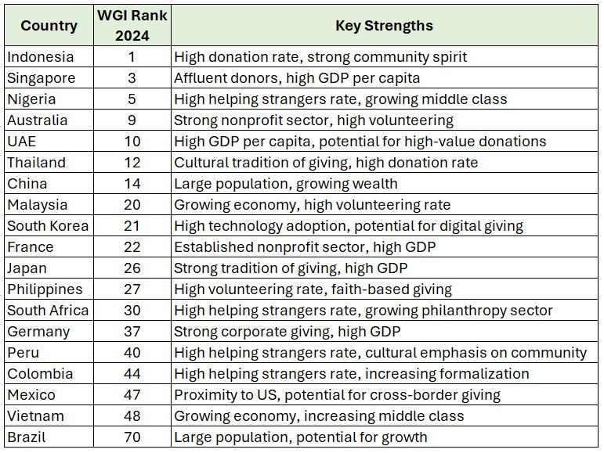

Top 15 WGI ranking

Slide 12
Competitive Benchmarking
US Philanthropic Landscape
Competitors Financials
Financial Ratios

Slide 13
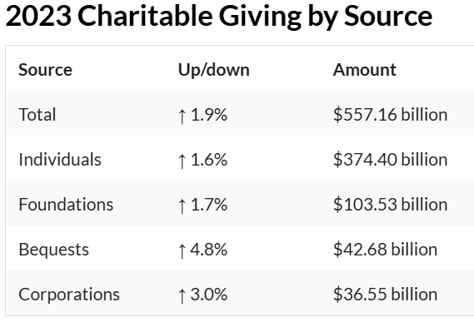
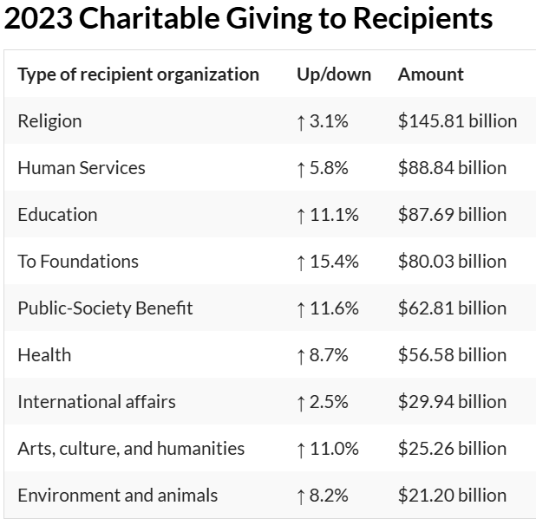
US Philanthropic Landscape
Approximately $557.16 billion to U.S. charities in 2023
USAID’s funding (~$43.8B)
GlobalGiving (>1% of total funding)
Notes:
https://givingusa.org/giving-usa-u-s-charitable-giving-totaled-557-16-billion-in-2023/

Slide 14
Competitors Financials
Organization | Year | Contributions, Gifts, Grants (in $ Mn) | Program Service Revenue (in $ Mn) | Other Revenue (in $ Mn) | Total Revenue (in $ Mn)
GlobalGiving | 2023 | 113.6 | 5.1 | 2.1 | 120.8
DonorsChoose | 2023 | 152.7 | N/A | 0.8 | 153.5
CAF America | 2023 | 813.1 | 1 | 2.61 | 816.4
Every.org | 2023 | 20 | 0.09 | 0.41 | 20.5
GoodStack | 2023 | 0.27 | N/A | N/A | 0.27
Myriad | 2023 | 117.6 | 2.7 | 0.9 | 121.3
CDP | 2023 | 29.5 | 0.63 | 0.56 | 30.7
Drive 99%+ revenue via contributions (CAF America: $816.4M).
Rely solely on donations, risking volatility (GoodStack).
Diversify with program services (GlobalGiving: 68%; Myriad: 10%).
Highlight sector scale gaps (816M vs.0.27M: CAF vs. GoodStack).
Pilot hybrid models to reduce donor dependence (e.g., fee-for-service).

Slide 15
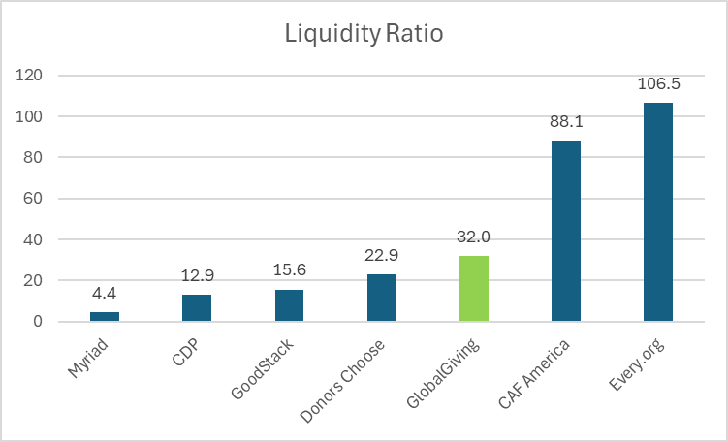
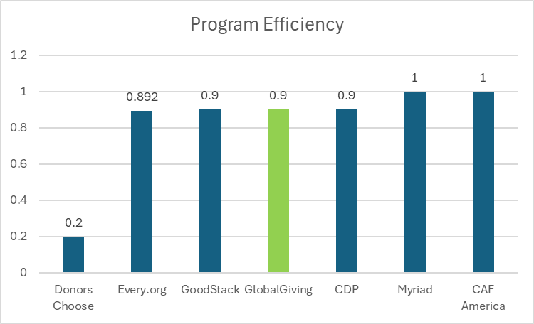
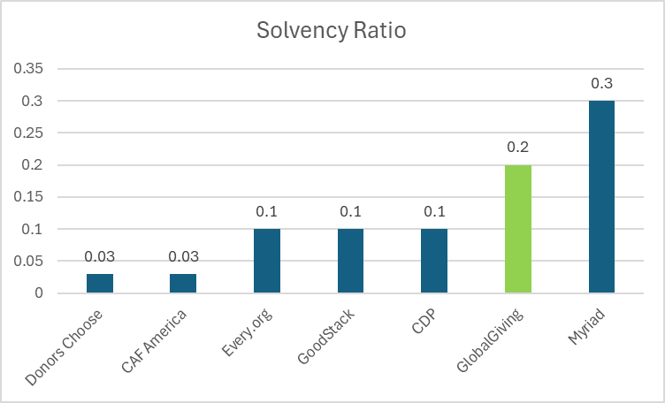
Financial Ratios
• Myriad (0.3) and GlobalGiving (0.2) show stronger solvency, relying less on debt.
• Donors Choose and CAF America (both 0.03) depend heavily on external funding, increasing long-term financial risk.
Current Ratio = Current Assets / Current Liabilities
Program Expense Ratio = Program Expenses / Total Expenses
• Every.org (106.5) and CAF America (88.1) have robust liquidity, easily covering short-term obligations.
• GoodStack (15.6) and Myriad (4.4) face liquidity risks, signaling potential cash flow challenges.
• CAF America, Myriad, and CDP (1.0 or 0.9) direct nearly all revenue to programs, maximizing impact.
• Donors Choose (0.2) lags, spending 80% of funds on overhead/fundraising.
Debt-to-Equity Ratio = Total Liabilities / Net Assets

Slide 16
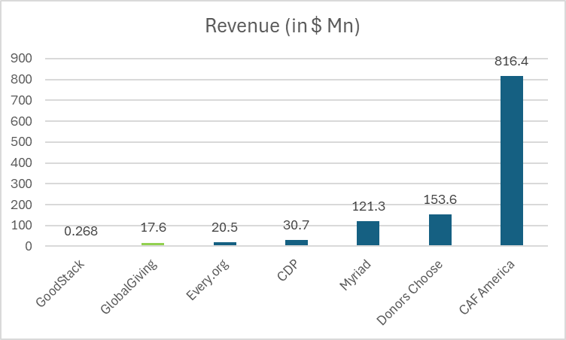
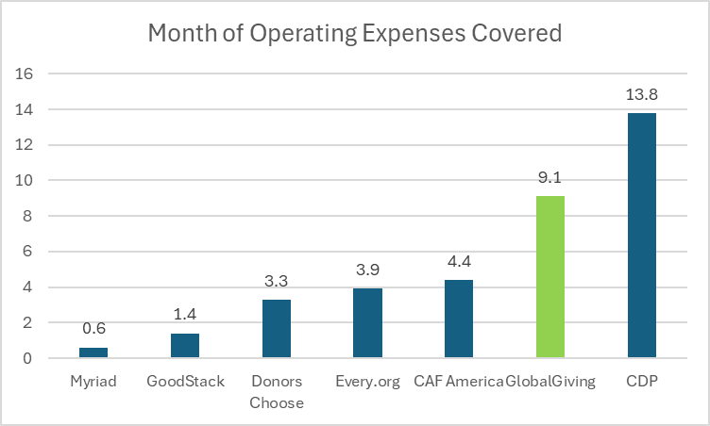
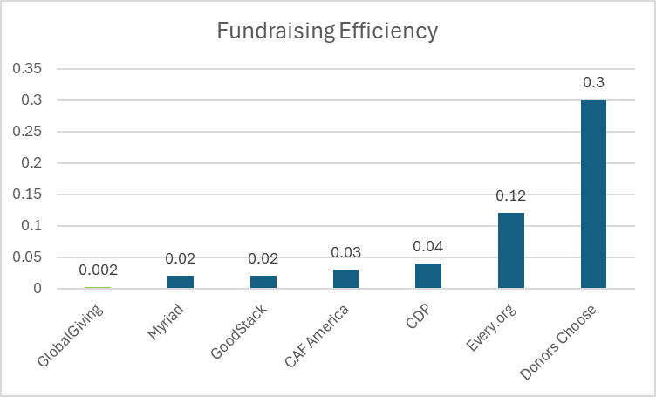
Financial Ratios (cont.)
• GlobalGiving (0.002) and CAF America (0.03) excel at cost-effective fundraising.
• Donors Choose (0.30) spends disproportionately on fundraising efforts.
Total Revenue
Months of Operating Expenses Covered =
Cash Reserves / Average Monthly Operating Expense
• Scale Disparity: CAF America (816M), GoodStack(268K).
• Risk Exposure: Myriad (0.6 months) and GoodStack (1.4 months) lack reserves, while CDP (13.8 months) and GlobalGiving (9.1 months) are resilient to disruptions.
• High-reserve orgs (CDP, GlobalGiving): Better positioned to weather crises, invest strategically, or scale programs.
• Low-reserve orgs (Myriad, GoodStack, DonorsChoose): Risk program cuts, staff reductions, or operational shutdowns during funding gaps.
Fundraising Efficiency Ratio =
Fundraising Expenses / Total Contributions

Slide 17
Strategy & Roadmap
Strategic Revenue Streams
Accelerating Growth: Strategic Levers
3-Year Roadmap
Final Metrics & KPIs
Investment Required

Slide 18
Strategic Revenue Streams (2025–2028)
Projected Path to $1Billion — Diversified & Future-Ready
Core Revenue Drivers
Individual Giving – $400M (50%): Core engine of support, fueled by grassroots campaigns and donor retention.
Foundations & Grants – $300M (35%): Anchored by institutional partnerships and multi-year funding.
Corporate Giving & CSR – $200M (25%): Strategic alliances, sponsorships, and impact-focused collaborations.
Growth & Innovation Levers
Planned Giving / Asset Transfers – $35M (5%): Legacy gifts and long-term donor engagement.
Innovation (NFTs, Web3, Emerging Tech) – $50M (10%): Experimental revenue from digital assets and decentralized platforms.
Embedded / API Revenue – $15M (2.5%): Monetization through platform integrations and white-labeled tools.
Total Projected Revenue: $1 Billion
Conservative: $1B → 8x ROI
Base: $1.25B → 10x ROI
Stretch: $1.35B → 12x ROI

Slide 19
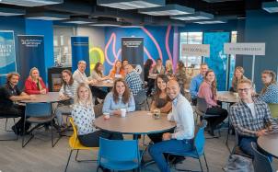
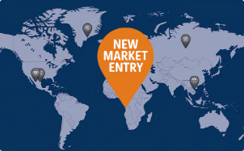
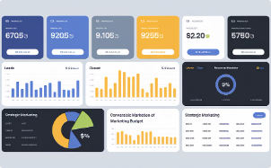

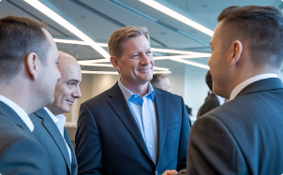
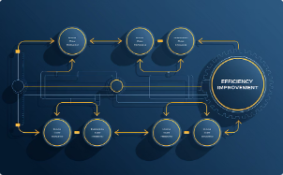
Accelerating Growth: Strategic Levers
Internal approaches to drive sustainable business expansion
Customer Retention
Geographic Expansion
Enhanced Marketing
Partner Co-branding
Customer retention fuels sustainable growth
Geographic expansion unlocks new markets
Enhanced marketing drives visibility
Partner co-branding amplifies reach
Donor Relations
Streamlined Processes
Donor relations strengthen loyalty
Like KYC, Partner Onboarding Streamlined to boost efficiency

Slide 20


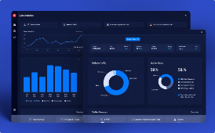


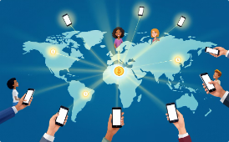

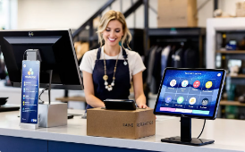

Advisory Services
Tax & Event Management
Premium Analytics
White-Label Licensing
Advisory services extend expertise to clients seeking specialized guidance
Tax/event management fills client needs with comprehensive solutions
Premium analytics creates value-add through data-driven insights
White-label licensing expands reach through partner distribution
Service Bundling
Diaspora Partnerships
Educational Alliances
Point of Sale - App & Check-out
Service bundling establishes baseline target for enhanced client value
Mobile payment integration connecting global communities
University and youth engagement expanding educational reach
PPOS and embedded giving enhancing transaction capabilities
External Growth - Strategic Partnerships & Channels
Government and foundation support providing financial backing
Institutional Funding

Slide 21
We’ve identified Indonesia, China, Australia, Mexico, and South Africa as the most promising markets for digital giving expansion, based on population size, philanthropic behavior, and economic growth potential.
Indonesia (270 million, 5% GDP growth): Leading in global giving rates, with platforms like GoGetFunding and SimplyGiving.
China (1.4 billion, 5% growth): Contributes $16 billion annually, focusing on digital initiatives, especially through SimplyGiving.
Australia ($9.5 billion in giving): A mature, high-trust market ideal for testing innovations.
Mexico ($5 billion in giving): Supported by GoFundMe, this market benefits from a growing middle class and cultural alignment.
South Africa ($1.5 billion in giving): An emerging market with significant needs, offering opportunities for impactful philanthropy.

Slide 22
3-Year Roadmap (2025–2028)
FY 2025 (low hanging fruits) Foundation Building | FY 2026 (low hanging fruits) Scaling Operations | FY 2027 Achieving Scale
Kick off ATLAS-powered NGO vetting & onboarding Begin donor segmentation & personalization pilots Partner with top 5 marketing agencies for P2P donor engagement Start $1/day donor campaign with matching fund corporates Launch co-branded fundraising with 10 corporate partners Participate in 3 global giving events (e.g., GivingTuesday) Donor Relationship Management Track Repeat Donors | IG: 500k, YT: 211.5k, TikTok: 10.1k Expand CSR white-label tools to 50+ corporates Localize platform in 5 additional languages Activate mobile giving in 6 new geographies Launch monthly donor subscription campaign with influencers Host 5 hybrid storytelling/donor showcase events Scale DAF + crypto-giving pilot tools Expand presence in 3 countries (Indonesia, Nigeria, Mexico) | Scale-up non core activities - revenue realization via analytics & event services Launch global “impact transparency” engine Expand regional field hubs across Africa, Asia, LATAM Reach 100K active NGOs and 1M recurring donors

Slide 23
Final Metrics & KPIs
We’ve identified critical performance indicators to drive sustained donor engagement, improved user experience, and measurable campaign ROI. Core Performance Metrics
Donor Retention Rate: Target 30% (current ~7%)
Campaign ROI per Dollar: Achieve 4.2x, in line with top-performing platforms
Email Click Rate: Increase open and click-through rates via segmentation and A/B testing
Donor Repeat Rate: Boost frequency of giving through lifecycle campaigns and personalized outreach
User Experience & Platform Engagement
Conversion Uplift via UX: Target +28% through UI improvements and simplified donation flows
Website UI Improvements: Implement accessibility and mobile-first design updates
App Usage: Drive higher engagement through push notifications and in-app storytelling
Multilingual Traffic Growth: Scale to 5x growth by launching in 8 new languages
Donor Relationship & Stewardship
Annual Thank-You Campaigns: Ensure all donors receive personalized, meaningful acknowledgments to encourage future giving

Slide 24
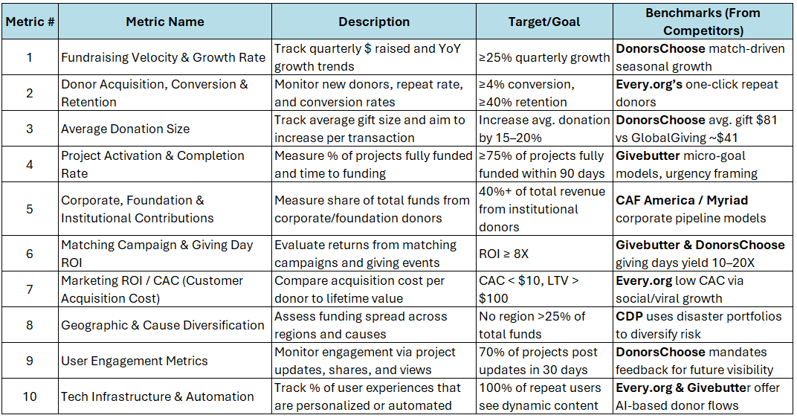
Key metrics to be tracked

Slide 25
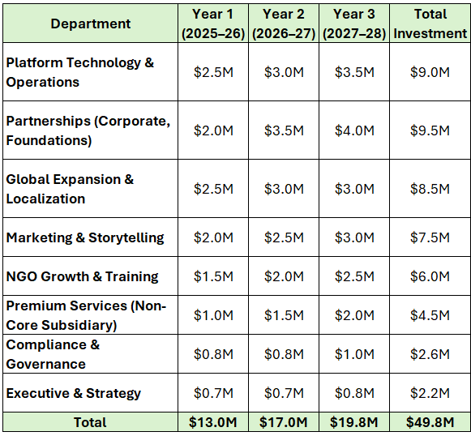
Investment Required - 0.5% of $1Bn

Slide 26
Global philanthropy market is projected to exceed $1 trillion by 2030
Current Cause Areas
Disaster Relief and Humanitarian Aid
Health and Medical Research (top 10% in US)
Education and Human Services (basic needs, poverty alleviation)Environment/Climate
Environment/Climate (Bezos Earth Fund, momentum into environmental philanthropy since 2023)
Emerging Cause Areas
Climate and Environment - Segments like renewable energy access, reforestation, and climate
Social Justice and Equity
Global Development and South-South Giving
Projections for 2030 - Deadline for the UN Sustainable Development Goals (SDGs)
Climate is expected to be a top cause by 2030
Education focus may shift to workforce development and tech education as economies change
Health
Technology for good

Slide 27
Closing Summary
GlobalGiving is uniquely positioned to lead digital philanthropy globally as the one who has Built the trust.
With $50M in phased investment, we can scale, innovate, and sustain impact.
Our roadmap includes:
Leverage ATLAS repository - “Google/ChatGPT of Philanthropy”
5 priority market expansions
100K+ NGOs activated - Instant Onboarding (KYC/Vetting process) - 3 mins
1M recurring donors - $1/Day - Micro donations
Donor Relationship management - Gen Z, diaspora, corporates, and HNWIs
1M TikTok and Instagram Followers, 1 video - reel or story every alternative day
Daily & Monthly Metrics to be tracked
Next Steps:
Approve strategic funding
Assign champions for oversight - Daily & Weekly Status Updates
Let’s shape the future of global giving—together.

Slide 28
APPENDIX

Slide 29
Data Sheets and Drive Link
Revenue Accounts
https://docs.google.com/spreadsheets/d/11adeAlC6AviB9HVqHHFzbTnmuQSWKnWmMekbw65kSik/edit?usp=sharing
(Please check slide 32- 33)
Financial Ratios
https://docs.google.com/spreadsheets/d/17Hh02H-wDHfvDAS6Q8K1ftmFCcXIiFUWp94TNEcXBLw/edit?usp=sharing
(Please check slide 14-16)
Detailed Competitor for Selection
https://docs.google.com/spreadsheets/d/1UrHkPNtBa6eLAfLFEOW2GNjngqKFoCXd/edit?usp=sharing&ouid=111263940115971759199&rtpof=true&sd=true

Slide 30
Form 990 & Audit Report
All of the Form 990 & Audit Report of the Competitors are available in the below google drive link:-
https://drive.google.com/drive/folders/1bygmcq1ndgFAl3GydGjPbY-LWdENuxQA?usp=drive_link Other Websites that were used to extract the information are mentioned below:-
Donors Choose | Charities Aid Foundation America | Every.org | GoodStack (est Percent) | Myriad | Center for Disaster Philanthropy
https://projects.propublica.org/nonprofits/organizations/134129457 | https://projects.propublica.org/nonprofits/organizations/431634280 | https://projects.propublica.org/nonprofits/organizations/611913297 |  | https://myriadusa.org/about/annual-financial-reports/ | https://projects.propublica.org/nonprofits/organizations/455257937
 |  |  |  | https://myriadusa.org/news/
 |  |  |  | https://projects.propublica.org/nonprofits/organizations/582277856

Slide 31
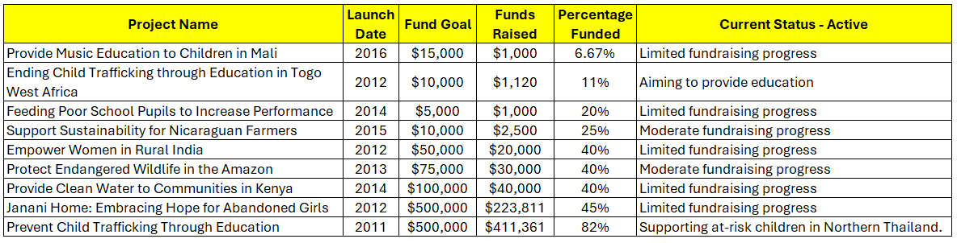
Challenging Initiatives
Weighted average of Percentage Fund= Total (Fund Goal x %Funded)/Total Fund Goal = 57.8%
These are a small subset of struggling projects among the active initiatives on Global Giving’s platform. Most have been active for over a decade with limited fundraising progress

Slide 32
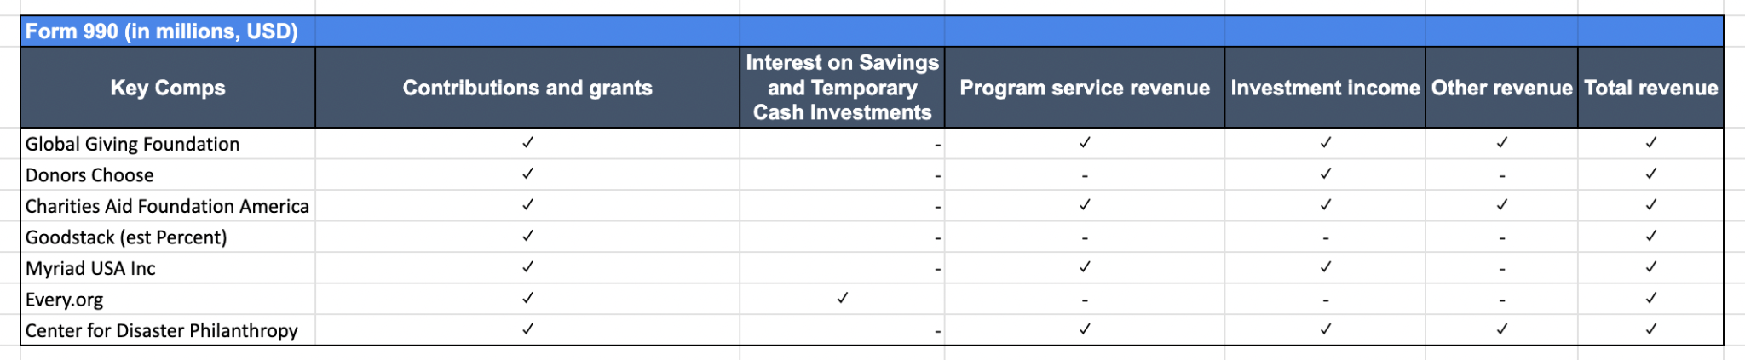
Revenue Headings - Form 990s

Slide 33
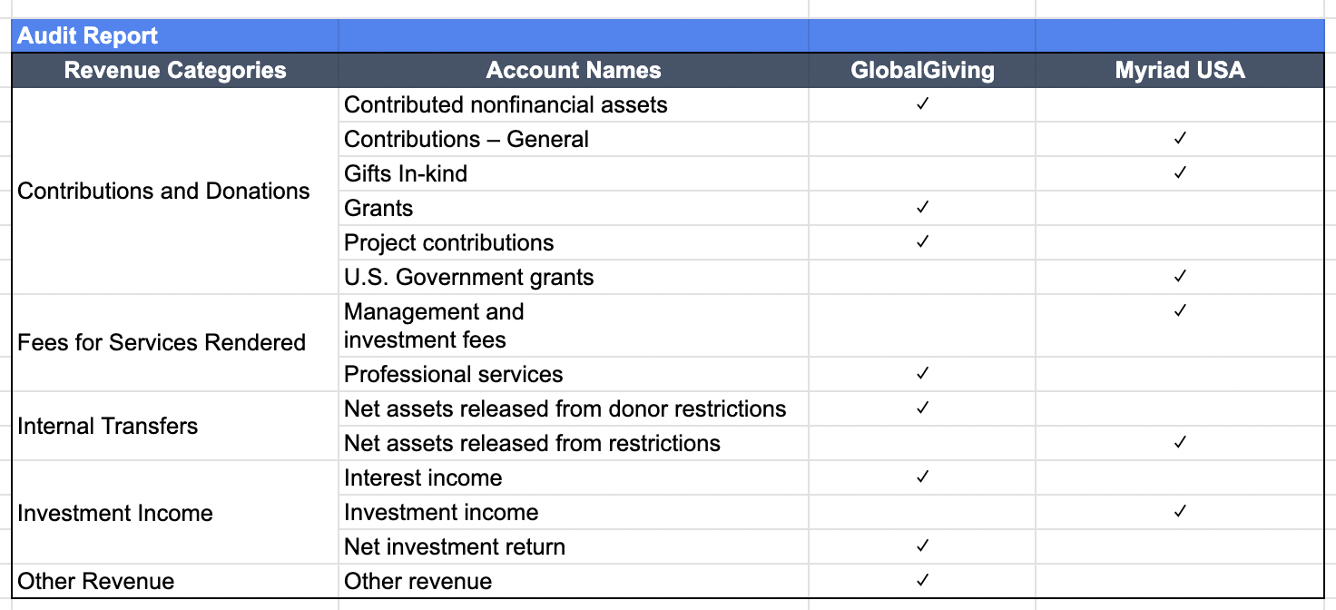
Revenue Headings - Audit report

Slide 34
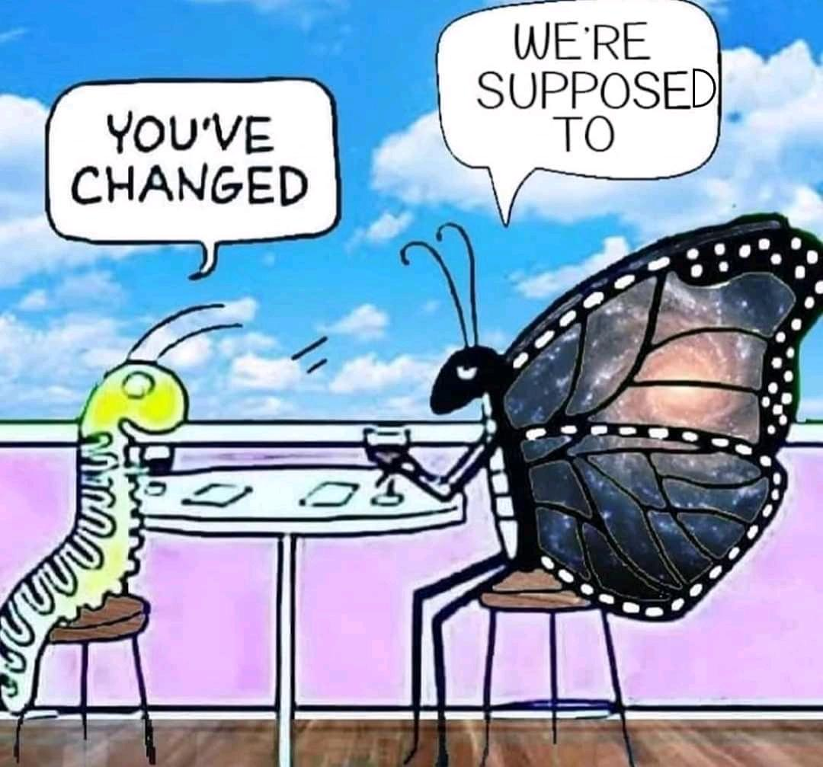
Global Trends & Opportunity
Digital Giving on the Rise
There's been a 35% surge (YoY) in digital donations across Europe, the UK, and MENA
With 5.2 billion users projected by 2026, digital wallets (e.g. Apple Pay) are on the rise
Spontaneous Methods Gaining Ground
Micro-donations (e.g. round-ups, in-app giving)
Cryptocurrency donations
QR code–based donations at events and storefronts
Smarter, Strategic Philanthropy
Donor-Advised Funds (DAFs)
Planned giving (estate-based)
Mission-aligned investing
This shows a move from one-time donations to long-term, impact-driven strategies.

Slide 35
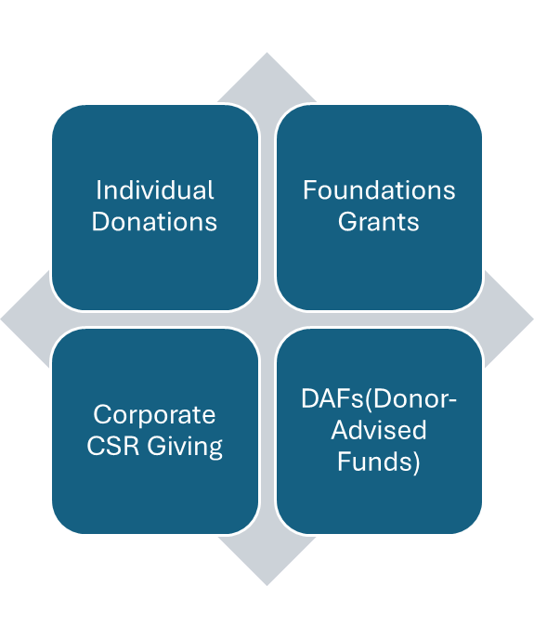
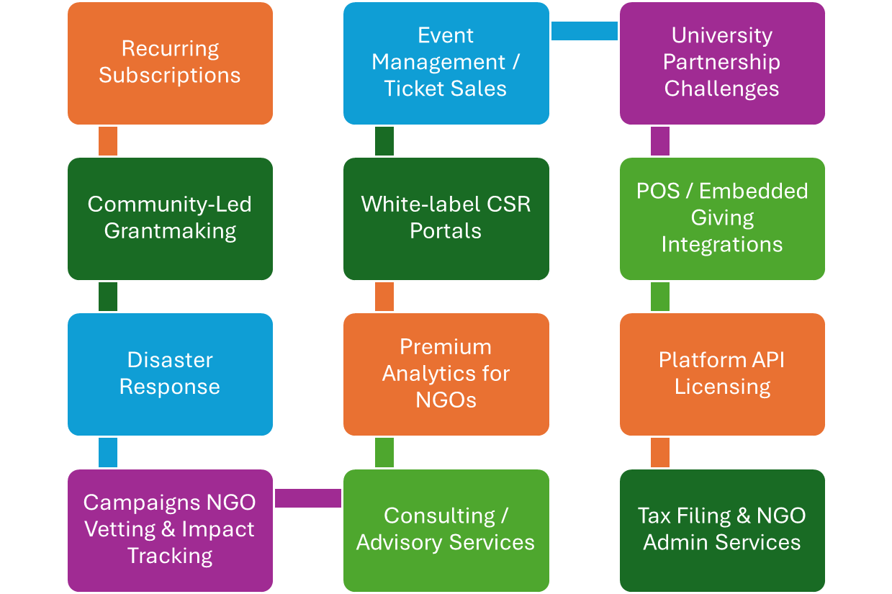
Core & Non Core Activities

Slide 36
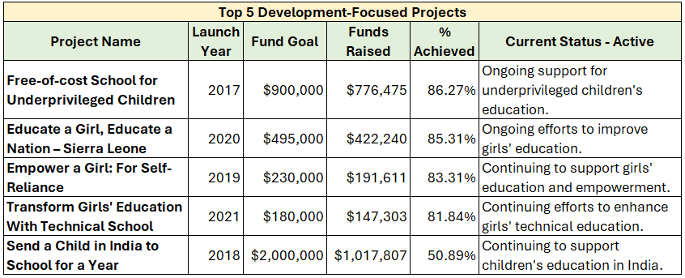
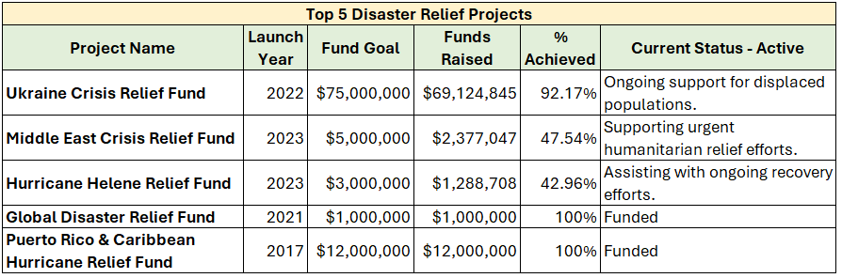
Success Stories

Slide 37
Strategic Growth Initiatives
Internal Levers
Increase Customer Retention
Expand Market Reach
Strengthen Marketing & Branding
Expand into new geographic markets and enhance online presence with multilingual capabilities.
Personalize account management through Donor Success Managers and share compelling donor stories and testimonials.
Boost advertising, co-branding with partners, and elevate sponsor visibility with advanced branding tools.
Optimize Operations
Enhance Donor Engagement
Streamline the donor vetting process and optimize recurring payment systems.
Appreciation to Top 3 donors—visit to the place of impact.
Sponsor Appreciation

Slide 38
Strategic Implementation Timeline
Year 1: Foundation Building
Expand Fortune 500 partnerships (12 → 25), with a tech-sector focus
Launch high-net-worth donor tier ($100K+)
Boost digital fundraising via SEO, paid ads, influencers (target: $2.5M)
Deploy AI for donor targeting and blockchain for transparency
Hire fundraising, grants, and marketing specialists
Year 2: Scaling Impact
Launch $1M+ named endowments with custom reporting
Expand global reach (8 new languages; APAC/MEA focus)
Accelerate grant processing (60% faster via AI)
Launch peer fundraising; deepen foundation partnerships
Year 3: Sustainability & Growth
Launch $50M Impact Investment Fund (target return: 8–10%)
Diversify revenue via subscriptions, micro-loans, social impact bonds
Expand into emerging markets (Asia, Middle East, Africa)
Secure $75M from ESG-aligned institutional funds
Form partnerships with 5+ municipal governments

Slide 39
Corporate Partnership Expansion
Audit 560+ existing partners; scale top performers
CSR portals, co-branded campaigns, payroll giving
Match tracking API + ESG dashboarding
Goal: $1M/year avg from 250+ partners

Slide 40
Governance and Compliance
Risk & Compliance Strategy
Platform Infrastructure & Security
NGO Ecosystem Strengthening
Donor Experience & Digital Storytelling

Slide 41
Risk & Compliance Strategy
To ensure operational resilience and regulatory alignment, GlobalGiving needs to enhance its compliance infrastructure with a proactive, tech-driven approach:
Strengthen cross-border compliance frameworks across high-risk and emerging markets by aligning with international standards and local regulations
Implement advanced fraud detection systems, including real-time risk scoring, Know Your Customer (KYC) protocols, and transaction monitoring powered by AI
Conduct routine security audits and establish governance dashboards to track policy adherence, risk exposure, and compliance performance
Dedicate 0.5% of the $1B revenue goal to compliance innovation, cybersecurity investment, and platform-wide infrastructure upgrades

Slide 42
Platform Infrastructure & Security
To elevate transparency, scalability, and trust, GlobalGiving should modernize its core technology stack through strategic investment in platform infrastructure:
Allocate $15M toward ATLAS 2.0, a next-generation platform integrating AI-driven insights and blockchain-backed transparency
Deploy advanced features such as smart contracts for secure fund disbursement, immersive VR storytelling, and real-time impact tracking layers
Scale operations to a Kiva-style model, enabling global access, decentralized participation, and seamless user experiences
Reinforce platform integrity by embedding trust, regulatory compliance, and data transparency at every layer of the technology ecosystem

Slide 43
NGO Ecosystem Strengthening
GlobalGiving needs to invest in strengthening its nonprofit network by equipping partners with advanced digital infrastructure and capacity-building tools:
Onboard 3,000+ NGOs through a structured digital pipeline, including certification, onboarding support, and performance tracking
Launch a multilingual Learning Management System (LMS), offering training in storytelling, grantwriting, and platform usage via the newly developed NGO Studio
Drive toward a 70% NGO activation rate, with content localized for cultural relevance and tailored training tracks to support sustainable impact

Slide 44
Donor Experience & Digital Storytelling
GlobalGiving should amplify donor engagement by harnessing emerging media formats and personalized content journeys:
Expand presence across digital storytelling channels, including Instagram, TikTok, YouTube, and podcast platforms
Leverage AI to generate immersive, donor-specific content that reflects project impact and progress in real-time
Incorporate gamification techniques such as challenges, milestones, and peer-to-peer campaigns to foster community-driven giving
Deploy seasonal giving campaigns and responsive crisis appeals to increase donor retention and emotional connection

Slide 45
Foundation & Grant Pipeline
Focus: Girls’ Education, Climate, Health, Disaster
Multi-year collaboratives, shared M&E
Impact dashboards + co-branded narratives
Target: $350M; Avg. grant $750K+; 60% renewal

Slide 46
Digital-First Individual Giving
AI-powered personalization & dashboards
$25/month avg x 500K recurring donors
One-click giving, roundup apps, story nudges
Goal: CAC < $10; LTV > $180; Retention > 65%

Slide 47
Web3 & Innovation Models
Accept BTC, ETH, USDC; tax-efficient giving
NFT-linked cause campaigns
Micro-investment philanthropy (returnable capital)
DAO-based grantmaking pilots

Slide 48
Platform & Technology Roadmap
ATLAS 2.0: AI + Blockchain Core
Smart contracts, VR tours, impact layers
Benchmark: Kiva-style scalability
Security: fraud detection, compliance, KYC

Slide 49
Global Expansion & Localization
New Markets: Brazil, Kenya, Nigeria, Indonesia, France, South Korea, UAE, Japan
Languages: Portuguese, Swahili, Bahasa, French, Korean, Arabic, Japanese
Regional Hubs: Field officers + local vetting + impact validation
Goal: 40% of funds from global south

Slide 50
NGO Ecosystem Strengthening
Pro Analytics, Grantwriting, NGO Studio
Certification tiers + LMS (multilingual)
Digital fundraising & storytelling tracks
Target: +3,000 NGOs onboarded, 70% active

Slide 51
Donor Engagement & Storytelling
Channels: Instagram, TikTok, YouTube, podcasts
Gamification: challenges, milestones, P2P
Holiday giving, matched themes, crisis appeals
AI-generated visuals, immersive content

Slide 52
Risk, Governance, Compliance
Security: AI-based fraud detection & vetting
Secure payments: encryption, KYC, Breach response
Governance: Board diversification & audit transparency
Compliance: Compliance automation (200+ markets)

Slide 53
Call to Action
Strategic Roadmap Taskforce
Oversight, feedback loop, KPI reporting
Total: $50M across 3 years
$38M into system/tech/infrastructure
$12M into staffing, field hubs, compliance
ROI estimate: 12x return on campaign & platform investments

